Slide 1
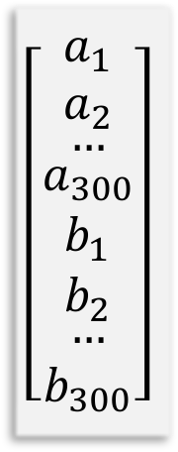
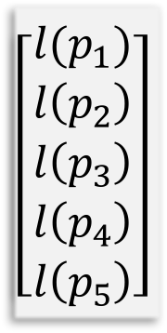
Learning Function
Input
Hidden
Layer 1
Hidden
Layer k
Output
$$\left[\begin{matrix}\begin{aligned}a_{1} \\ a_{2} \\ \begin{aligned}… \\ \begin{aligned}a_{300} \\ \begin{aligned}b_{1} \\ b_{2} \\ \begin{aligned}… \\ b_{300}\end{aligned}\end{aligned}\end{aligned}\end{aligned}\end{aligned}\end{matrix}\right]$$
a_{h}(z)
$$\left[\begin{matrix}\begin{aligned}l(p_{1}) \\ l\left(p_{2}\right) \\ \begin{aligned}l\left(p_{3}\right) \\ \begin{aligned}l\left(p_{4}\right) \\ \begin{aligned}l\left(p_{5}\right)\end{aligned}\end{aligned}\end{aligned}\end{aligned}\end{matrix}\right]$$
…
a_{h}(z)
a_{out}(z)
a_{h}(z)
300 x 1
N_{L1} nodes
N_{Lk} nodes
5 x 1
Update Function

Slide 2
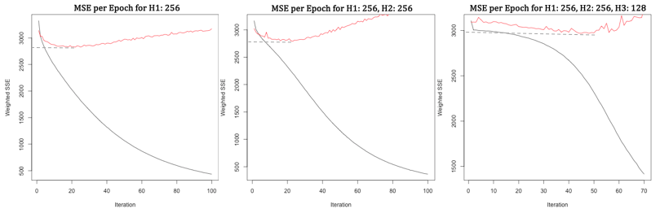

Slide 3
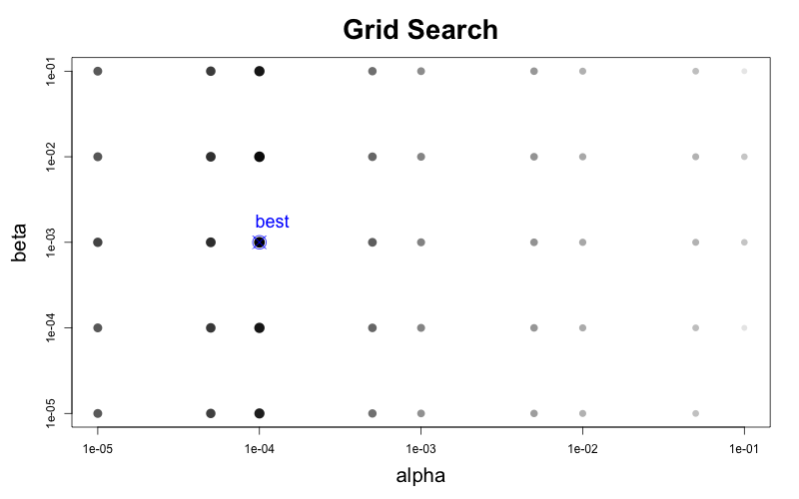

Slide 4
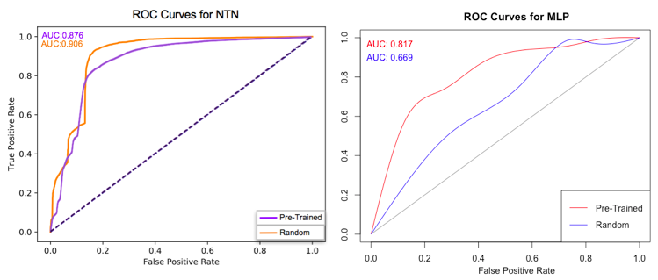

Slide 6
